Slide 1

PERSONALITY TRAIT PREDICTION
Rohin Ambati 20104068
Karan Maurya 20104070
Rupesh Mishra 20104100
Atharva Ankalwar 20104098
Project Guide
Mrs. Yaminee Patil

Slide 2
Contents
Introduction
Objectives
Scope
Literature Survey
Proposed System
Features and Functionalities
Project Outcomes
Block Diagram/Flow Chart
Use Case/DFD
Technology Stack
Suggestions in Review-1
Result and Discussion
Conclusion and Future Scope
References

Slide 3
1. Introduction
Data Science and AI are revolutionizing the planet through technical transformations. We can observe many machine learning applications in our day-to-day lives, but one of the greatest applications of machine learning is to classify individuals based on their personality traits. Every person on the planet is unique and carries a unique personality trait.
The big five personality traits , often mentioned as OCEAN model, are Openness, Conscientiousness, Extroversion, Agreeableness, and Neuroticism. These five personality traits represent broad domains of human behavior and account for differences in both personality and decision making.

Slide 4
Problem Identified :
Nowadays, personality assessment has become the most used test to hire many employees. As a result, we require technology which will predict the personality of the candidate, save time and reduce the workload of HR department thereby making it easier for them to shortlist the efficient candidates for the company.
Solution Proposed :
The solution proposed is the Personality trait prediction system. It is based on identifying the personality of an individual using machine learning algorithms to predict the personality of the user. The main aim of our project is to build a more reliable and smarter prediction system.

Slide 5
2. Objectives
To shortlist the right candidate according to the skills and experience.
To eliminate the manual traditional recruitment process.
To automate the recruitment process thereby saving cost and time considerably.
To enhance human behaviour research and decision making process.
To uplift marketing strategies which could target specific type of people.

Slide 6
3. Scope
This Personality Prediction Model can be used in E-commerce sites, in Competitive exams, Psychometric tests, Matrimonial sites, Government sectors like Army, Navy, Air force. Thus, the personality is automatically classified by the system after user attempts the survey by the data set provided in the back end.
Personality analysis and prediction is more in recent times so further in future more personality traits can be added. Any improvement can be done using the data set and algorithms to improve the accuracy and can be helpful for career guidance module.

Slide 7
4. Literature Survey
Sr.no | Title | Author(s) | Year | Outcomes | Methodology | Result
1 2 3 | “Predicting personality traits with social media” “Personality Trait Prediction using Twitter Data and Deep Learning” “Predicting Big Five Personality Traits from Linguistic Data” | Youyou, Wu, and Kosinki Kumar Rastogi, and Varshney Tausczik and Pennebaker | 2015 2018 2010 | Achieved high accuracies in predicting personalities from Facebook likes, with best model achieving correlation of 0.56 for extraversion and 0.50 for Openness. Achieved high accuracies in predicting personalities from Twitter data, with best model achieving correlation of 0.68 for extraversion and 0.64 for Openness. Found that certain linguistic Features(like – use of positive emotion words) were consistently associated with certain personality traits, while other features were more variable. | Analyzed social media Data (Facebook like) using machine learning algorithms - random forest and linear regression to predict OCEAN model. Applied deep learning techniques – long short term memory networks to predict OCEAN model based on Twitter data. Conducted meta-analysis of studies that used linguistic data to predict big Five personality traits (OCEAN). | Found Facebook likes can be used to predict personality traits with high degree of accuracy. Discovered that deep learning techniques can be used to accurately predict personality traits from twitter data. Learned a new category linguistics that can be used to determine traits.

Slide 8
5. Proposed System
Personality is useful for recognizing how people lead, influence, communicate, collaborate, negotiate business and manage stress. Personality is one of the important main features that determines how people interact with outside world. This project is helpful where we have data related to personal behavior.
This personal behavior data can be useful for identifying person based on his/her personality traits. The personality characteristics will be already stored in database. Later when user enters his personality characteristics his personality is examined in database and system will detect the personality of user.

Slide 9
6. Features and Functionality
Provides detailed analysis of the user’s personality.
Helps users to analyse their soft skills and target the weak areas.
They can upload their respective CV or Resume.
The GUI is simple, attractive and user-friendly.
User can fill the questionnaire and submit responses.
Personality characters can be stored in database.

Slide 10
7. Outcome of Project
User can enter the details.
User can answer the questions.
System will scan the responses and fetch the important details.
Dataset will analyse the answers fed and predict the personality.
Result page will show everything in a summarized manner.
This project will help the user to write the test and check its own personality.
From the classification, the person can view the type of personality and can improve based upon the results.

Slide 11
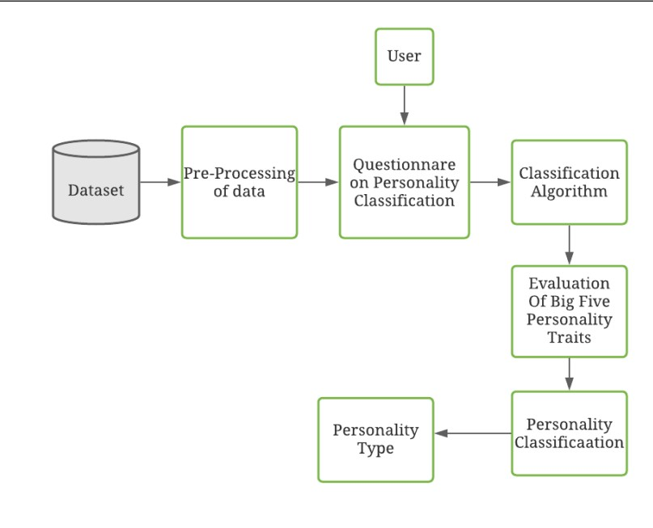
8. Flow Chart

Slide 12
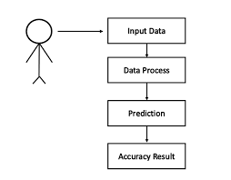
9. Use Case Diagram

Slide 13
10. Technology Stack
1. Frontend :- Python
2. IDE :- VS Code
3. Algorithms :- Logistic Regression
It contains two method which train the model and predict the result by giving the various values. train method: It read the dataset for training the model from a csv file and build a model using Logistic Regression

Slide 14
11. Suggestion in Review 1
Change the Use Case diagram
Use bullet points
Literature survey should be in tabular format
Elaborate conclusion and future scope
Justify and align content properly

Slide 15
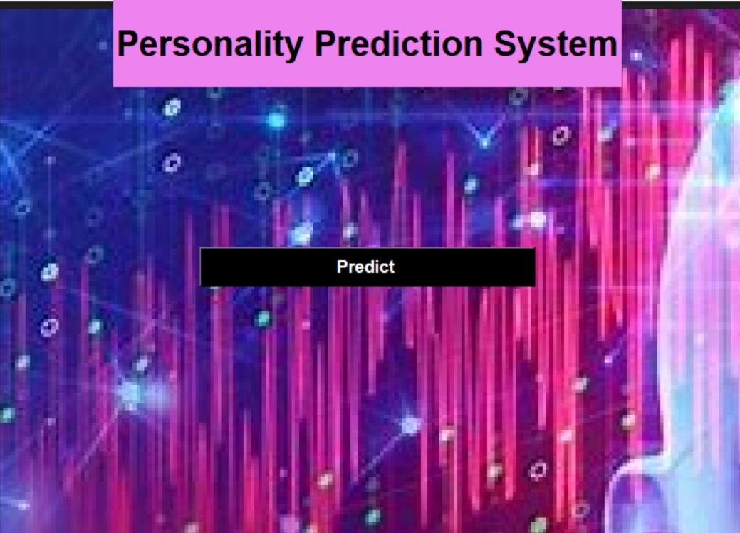
12. Result and Discussion
Home Page:

Slide 16
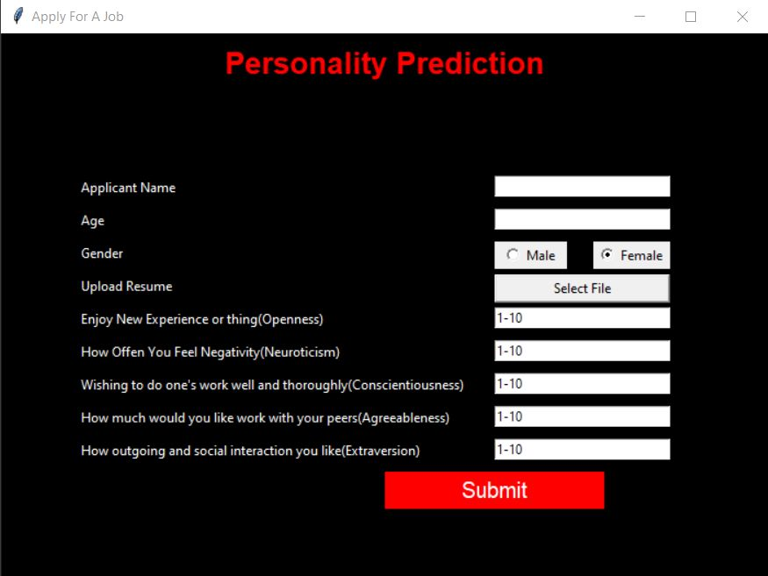
12. Result and Discussion
Main Page:

Slide 17
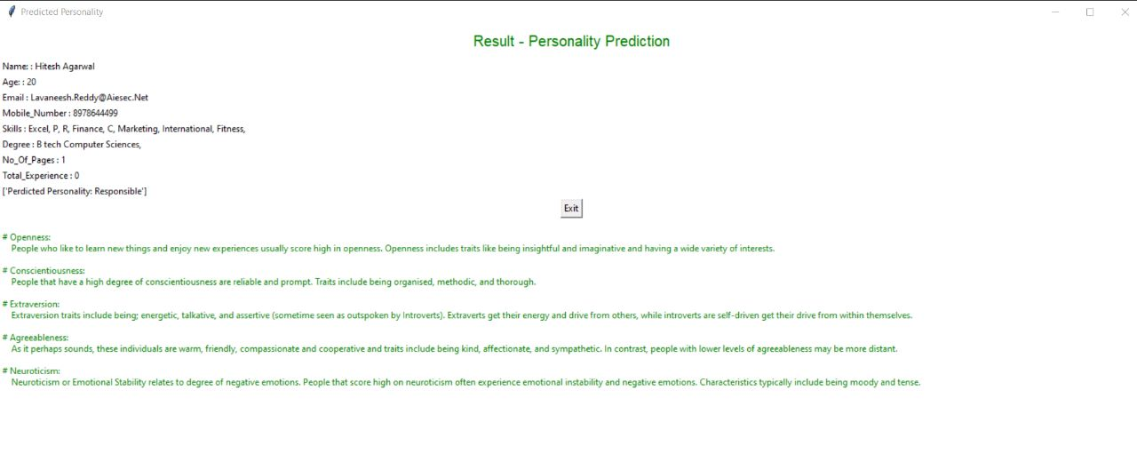
12. Result and Discussion
Result:

Slide 18
13. Conclusion & Future Scope
Conclusion:-
In this project, we discussed about how the personality is identified using different classification algorithms. Here we study relationship between user and his/her personality. In this we used logistic regression because it gives best accuracy while comparing to other algorithms that are used previously like naive Bayes , SVM , Logistic regression is fast and give accurate results compared to other algorithms. This project helps to write the personality test and check the personality of the person. From the personality classification, the person can view the type of personality and can improve the personality based upon the results.
Future Scope:-
We can modify the existing system and attach it to a questionnaire so that the personality score and the aptitude score will be calculated at the same time thereby reducing the workload. This Personality prediction system can be extended further to other domains like Telecom, Health-care, E-commerce and public sector jobs. Personality analysis and prediction is more in recent times so further in future more personality traits can be added. Further any improvement can be done using the data set and algorithms to improve the accuracy and can be helpful for career guidance module, if user has good speaking and convincing skills.

Slide 19
14. References
John, O. P., Naumann, L. P., & Soto, C. J. (2008),In Handbook of personality: Theory and research (Vol. 3, pp. 114-158). Guilford.
Lippa, R. A. (2010). Gender differences in personality and interests: When, where, and why? Social and Personality Psychology Compass.
https://youtu.be/n1TCvsKUEZ8
https://youtu.be/Cavebr_NNq8
https://nevonprojects.com/personality-prediction-system-through-cv-analysis/

Slide 20
Thank You!

